Slide 1
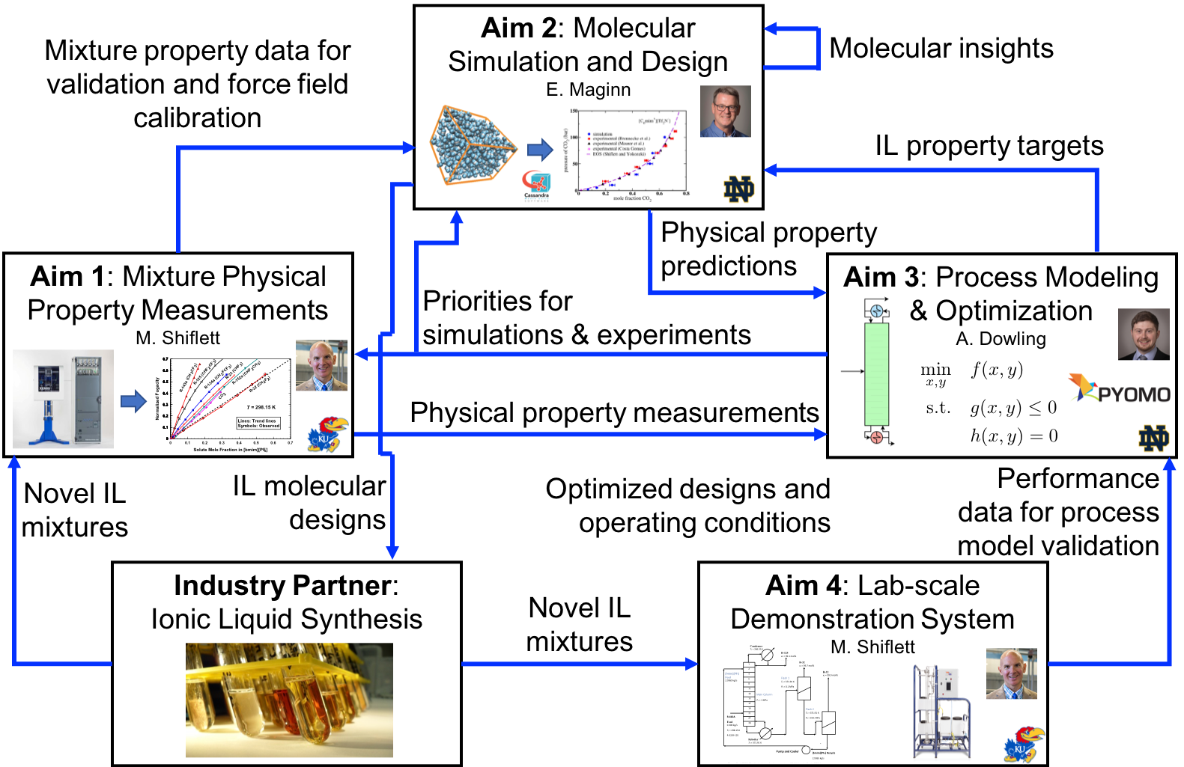

Managing Model and Data Alternatives with the Design of Ionic Liquid Enabled Separations of High Global Warming Potential Hydrofluorocarbon Refrigerants
Bridgette J. Befort, Alejandro Garciadiego, Gabriela Franco, Edward J. Maginn, and Alexander W. Dowling
Last Updated: April 26, 2022
Grant No. 1917474
Notes:
15 minutes

Slide 2


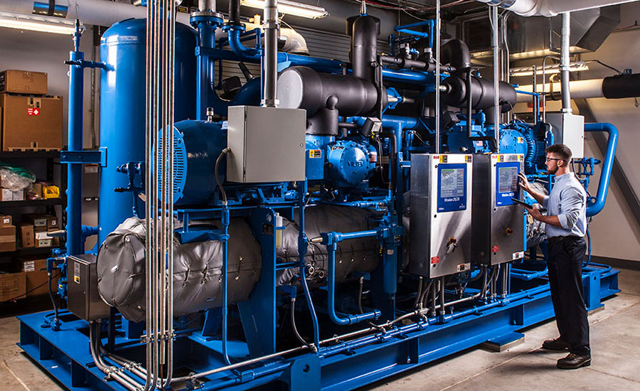
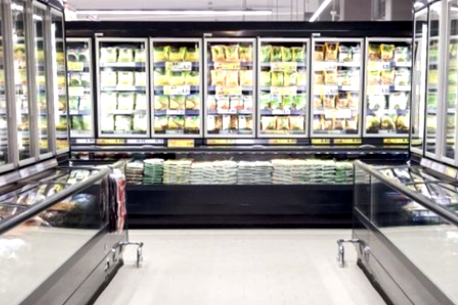
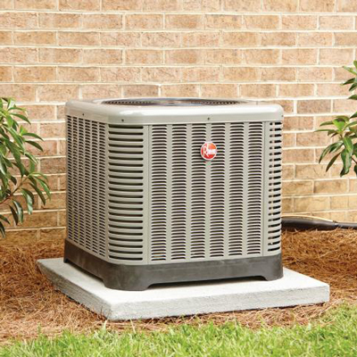
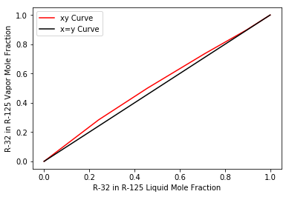
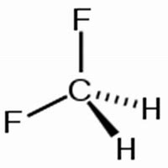
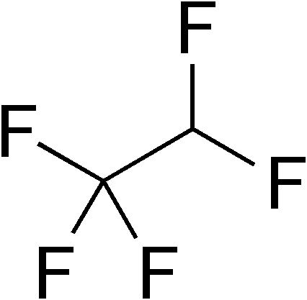
Sustainable solutions to HFC refrigerant phaseout are necessary
Hydrofluorocarbons (HFCs)
Market: Thousands of tons
High economic value ($5/kg)
Industrial
Commercial
Residential
Separation of low- and high-GWP HFC components from existing refrigerant mixtures is worthwhile
Environmental Significance
Global warming potential of HFC refrigerants
HFC-32
HFC-125
Azeotrope
+
=
R-410a
Existing Technology
Infeasible due to high energy requirements or lack of separating agents
50% HFC-32
50% HFC-125
GWP: 675
GWP: 3500
GWP: 2088
Novel technology is required to separate HFC refrigerant components!
Refrigerants Environmental Data. Linde Gases AG.
Goetzler et al. US Department of Energy and Navigant Consulting. (2014).
Oak Ridge National Lab. (2005).
Haynes, W.M. Thermophysical Properties of HCFC Alternatives. (1996).
Notes:
The systems we will apply this work to are HFC refrigerant mixtures, like R-410a. These are scheduled for phaseout under international agreements because of their high global warming potentials. To just dispose of these would be wasteful because the individual components can be reused and recycled. However, R-410a and other refrigerants are engineered as azeotropes and so separating the components is not feasible with our current technology and we need novel solutions for how to do this.

Slide 3
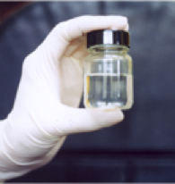
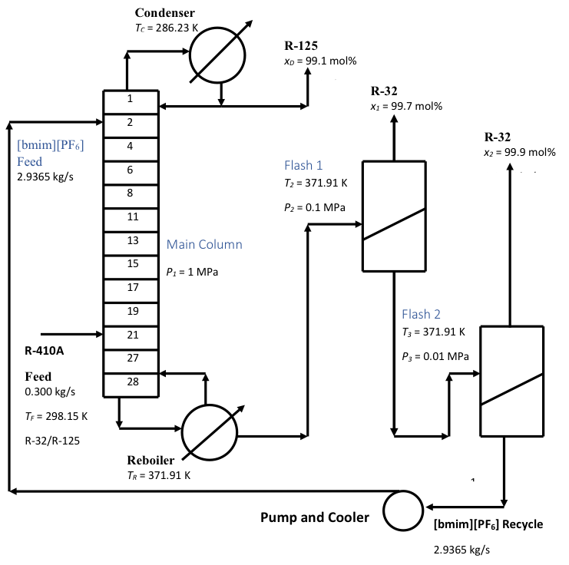
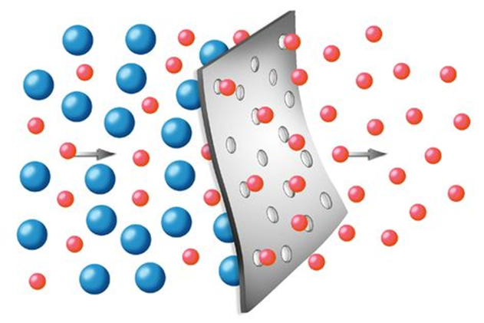

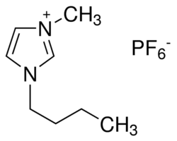
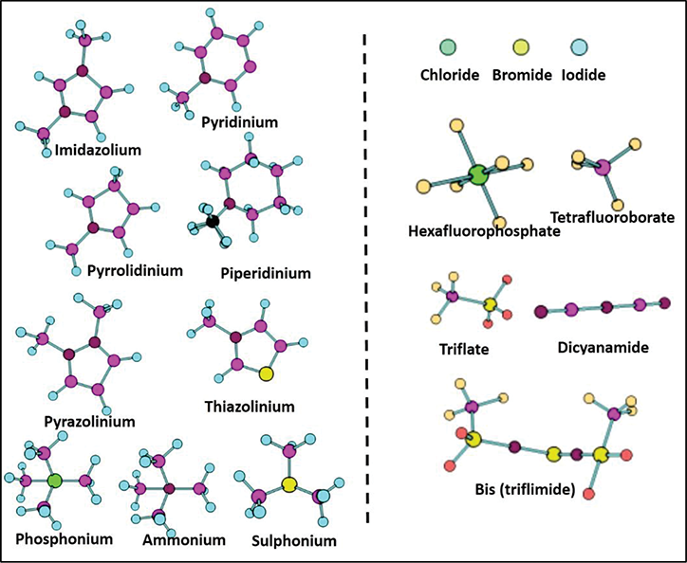
Ionic liquids enable separations of the future
Ionic Liquid
Opportunities for Optimization
Salt with low melting point and low volatility
Process Design
Configuration Technology
Operating Conditions
Recycle!
Reuse!
Q=652.15 kW
Extractive Distillation
Membranes
[bmim][PF₆]
1-butyl-3-methylimidazolium hexafluorophosphate
IL Molecular Design
Challenge
Designer solvent
10⁶ (conservative) ILs
Edisonian Trial & Error
Expensive
Inefficient at capturing design tradeoffs
What tools are necessary to exponentially increase the speed of molecular and process design?
Shiflett, M. B. and Yokozeki, A. Chimica Oggi - Chemistry Today, 24(2). (2006).
Devaki, S. J. and Sasi, R. IntechOpen. (2007).
Notes:
How to do exponentially faster molecular and process design?

Slide 4
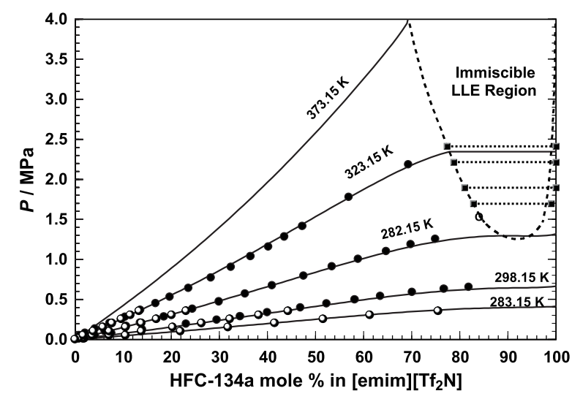
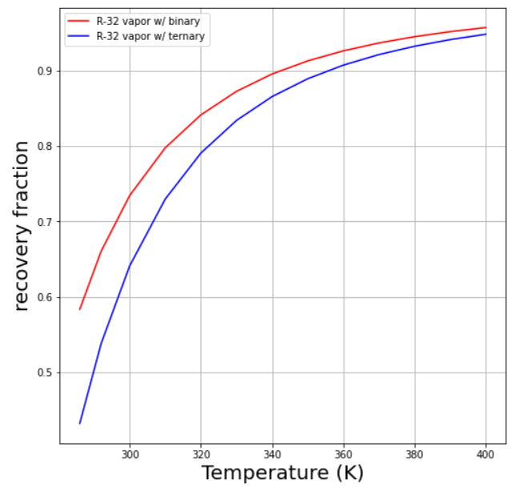
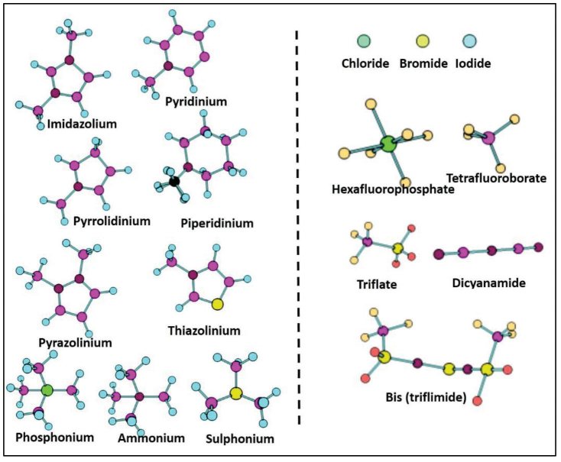
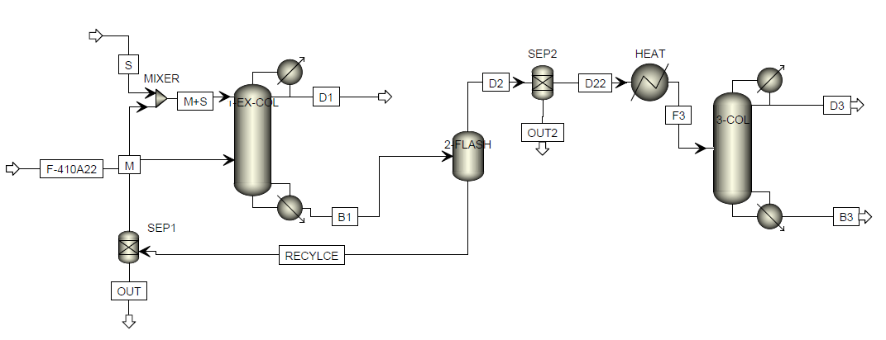
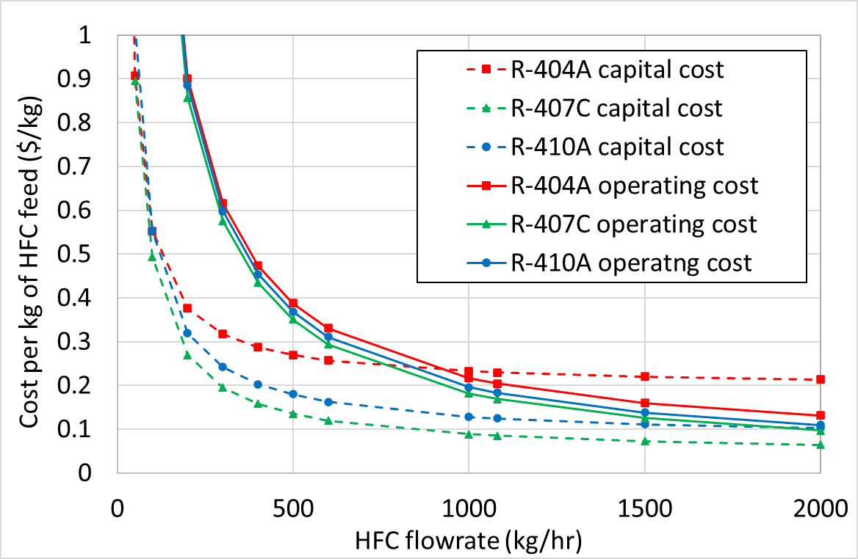

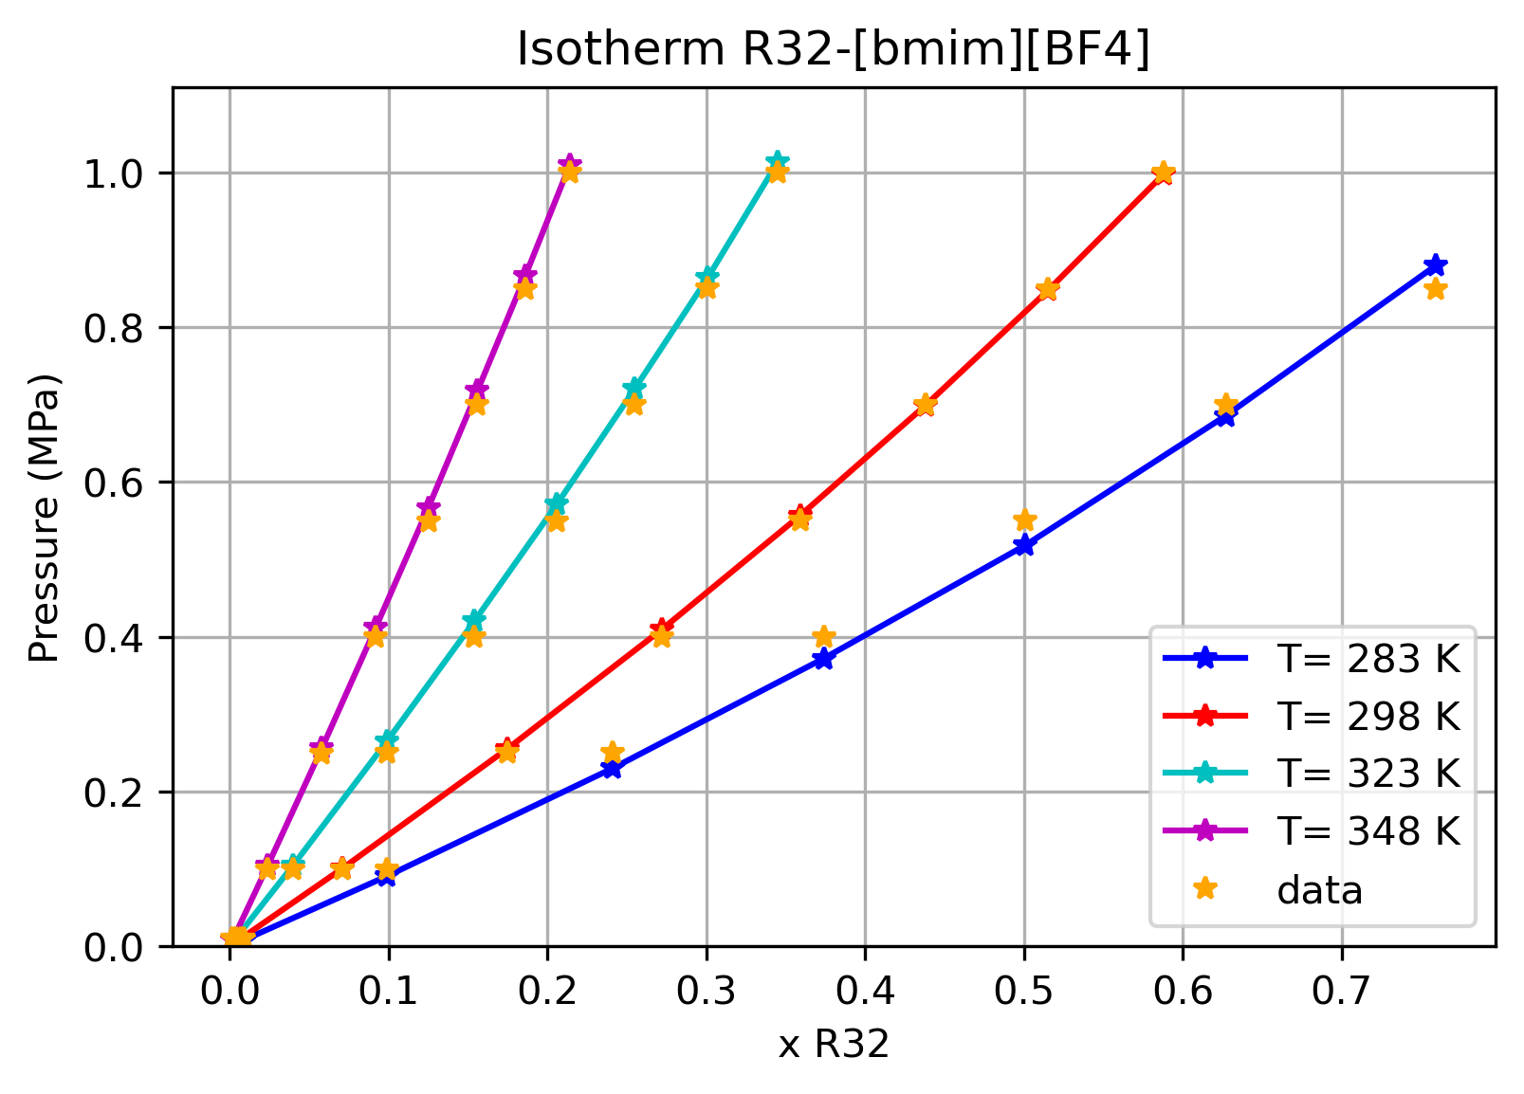
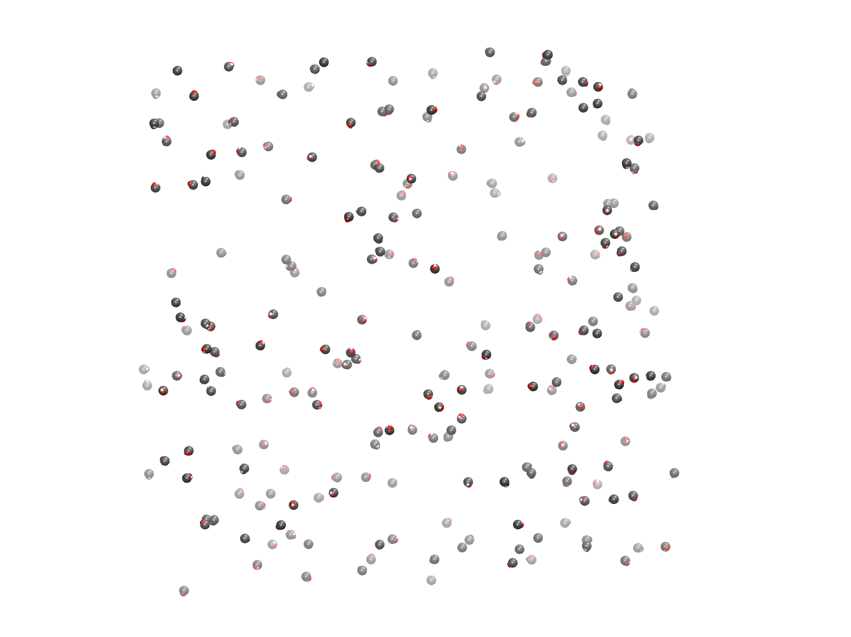
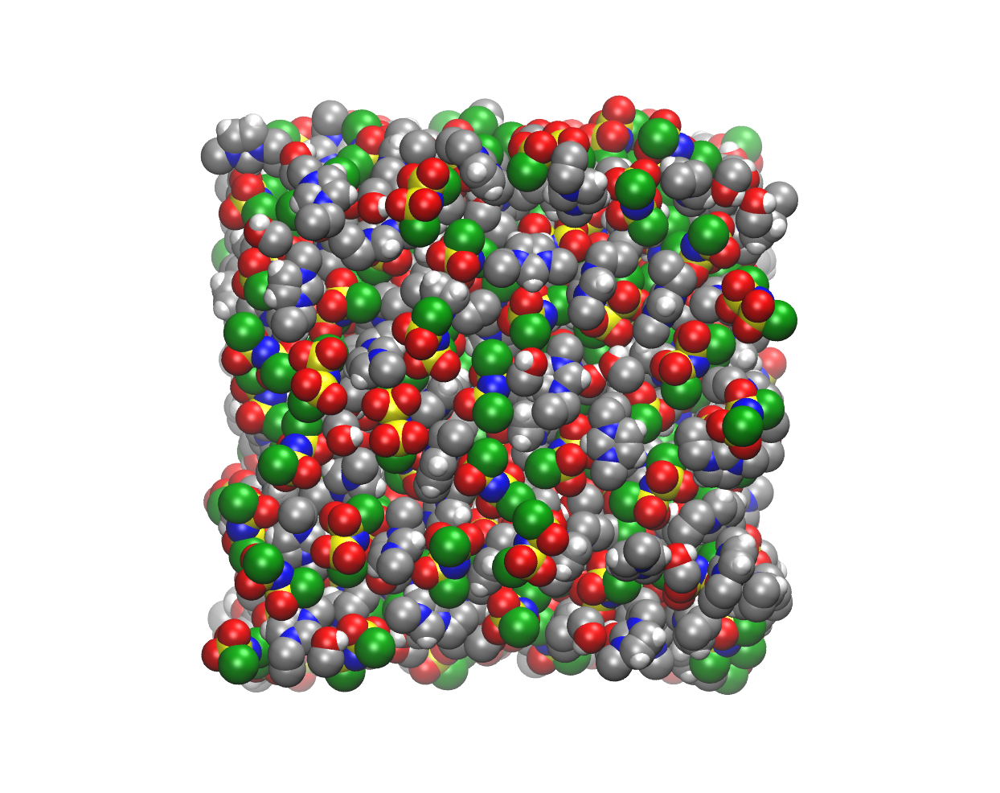



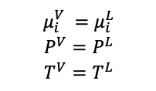
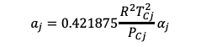
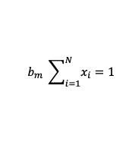
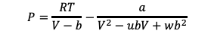
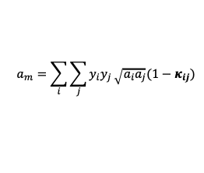

Our data-to-design framework helps address these challenges
An integrated research strategy which leverages computational molecular and process design tools, validated by experiments, enables us to systematically address these opportunities for optimization
62c @ Monday, 11/8, 8:20 AM Sheraton Back Bay, Back Bay Ballroom C
From Data to Process Design: Modeling Azeotropic Separation of High Global Warming Potential Hydrofluorocarbon Refrigerants Using Ionic Liquids
Experiments
Thermophysical Property Targets & IL Design
Process Design
Recovery Fraction
Temperature
Technoeconomic
Analysis
Turnaoglu, Ritchie & Shiflett (2019), J. Chem. Eng. Data
Shiflett, M. B. and Yokozeki, A. Chimica Oggi - Chemistry Today, 24(2). (2006).
Thermodynamic Modeling & Parameter Estimation
Molecular Simulations
Vapor Box
Liquid Box
$$P=\frac{RT}{V−b}−\frac{a}{V^{2}−ubV+wb^{2}}$$
$$a_{m}=\sum_{i}{\sum_{j}{y_{i}y_{j}}\sqrt{a_{i}a_{j}}(1−κ_{ij})}$$
$$μ_{i}^{V} =μ_{i}^{L}$$
$$P^{V}=P^{L}$$
$$T^{V}=T^{L}$$
$$a_{j}=0.421875\frac{R^{2}T_{Cj}^{2}}{P_{Cj}}α_{j}$$
$$b_{j}=0.125\frac{RT_{Cj}}{P_{Cj}}$$
Mullen, Corcelli & Maginn (2018), : J. Phys. Chem. Lett.
$$b_{m} \sum_{i=1}^{N}{x_{i}}=1$$

Slide 5
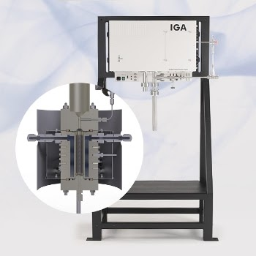
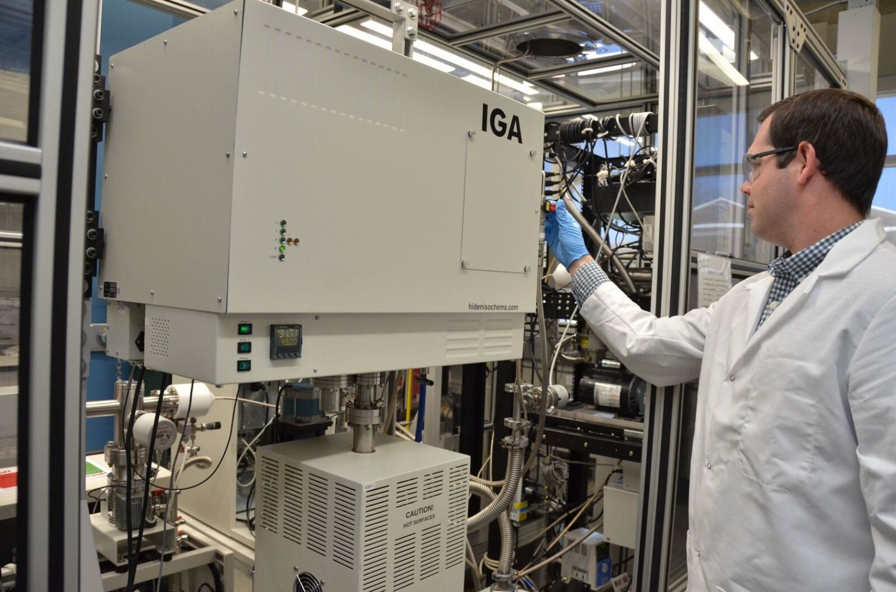
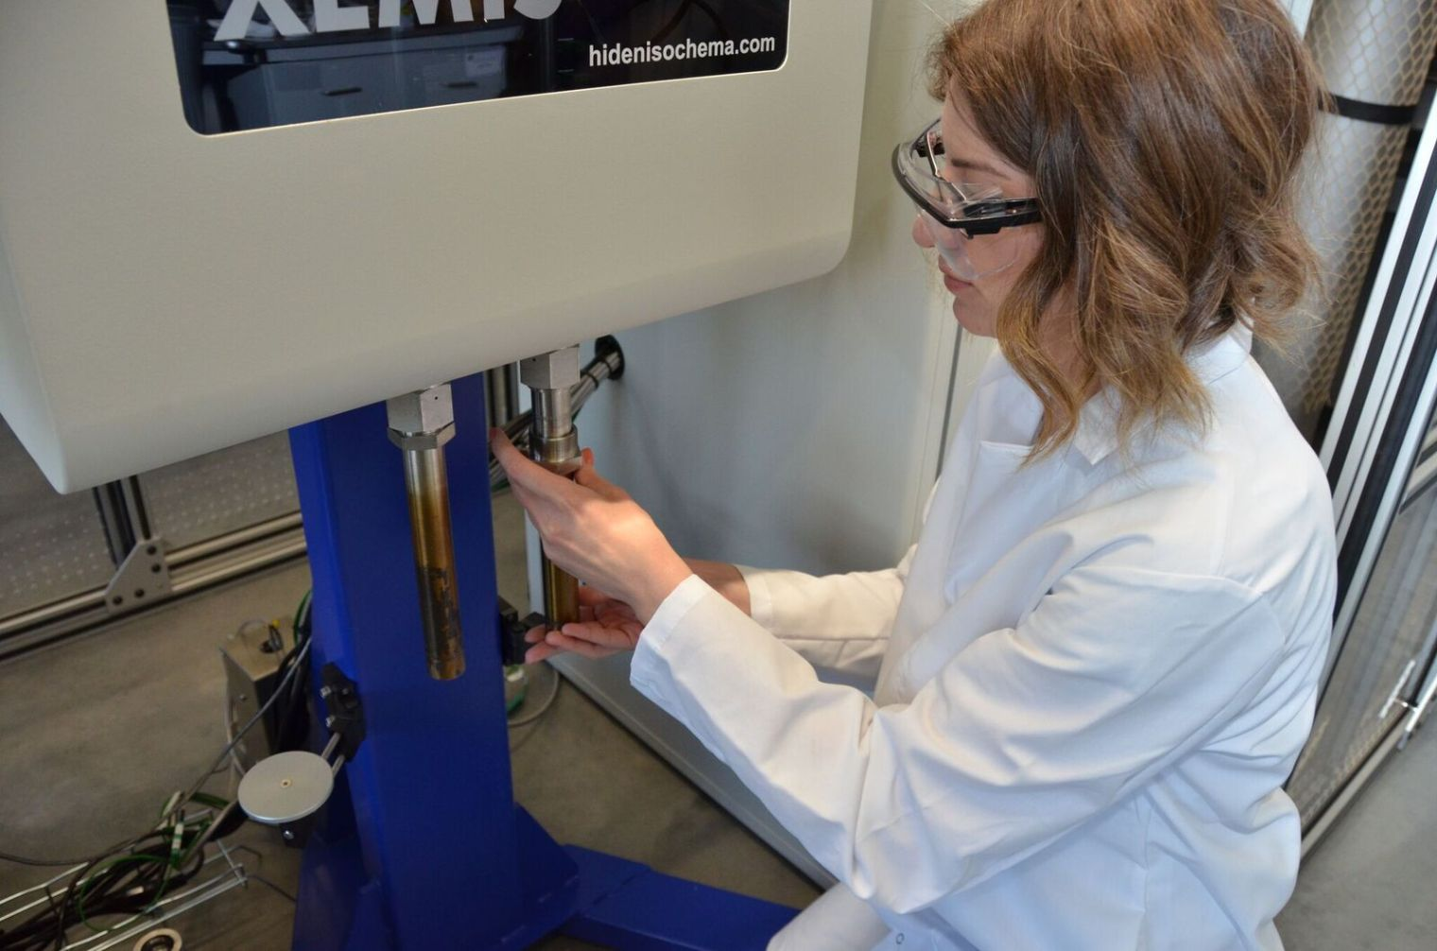


Experimental data is available at a variety of conditions
IGA: Gravimetric Gas and Vapor Sorption Analyzer
Binary measurements: IL and one HFC
1 IL @ varying temperatures
[pre-2015]
XEMIS: Next Generation Gravimetric Sorption Analyzer
[emim][Cl]
[hmim][I]
[hmim][Br]
[pmim][Cl]
[bmim][Cl]
[hmim][Cl]
[P_{14,6,6,6}][Cl]
Ternary measurements: IL and two HFCs
Multiple ILs @ 1 temperature
[2015-present]
Yokozeki, A., & Shiflett, M. B. (2010). J. Supercrit. Fluids.
Baca, K. Olsen, G. Matamoros Valenciano, L. Bennet, M. Haggard, D. Befort, B. Garciadiego, A. Dowling, W. Maginn, E. Shiflett, M. Sus. Chem. & Engr. (2021)

Slide 6
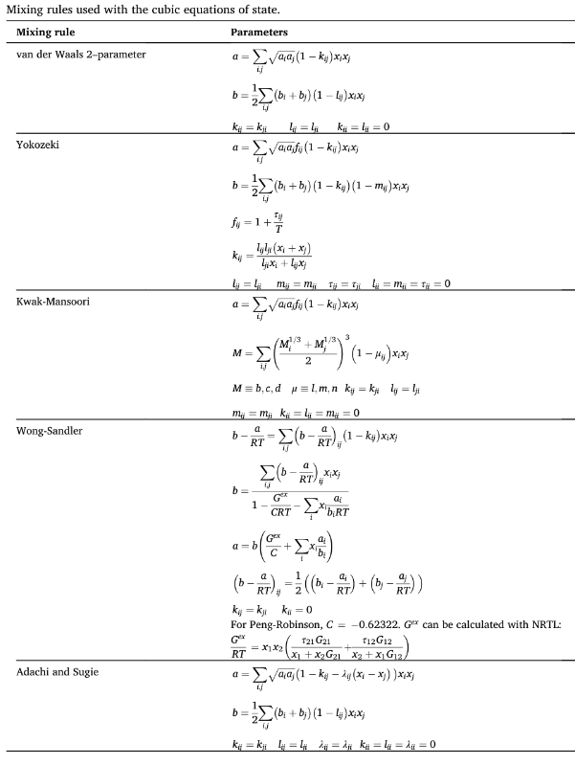
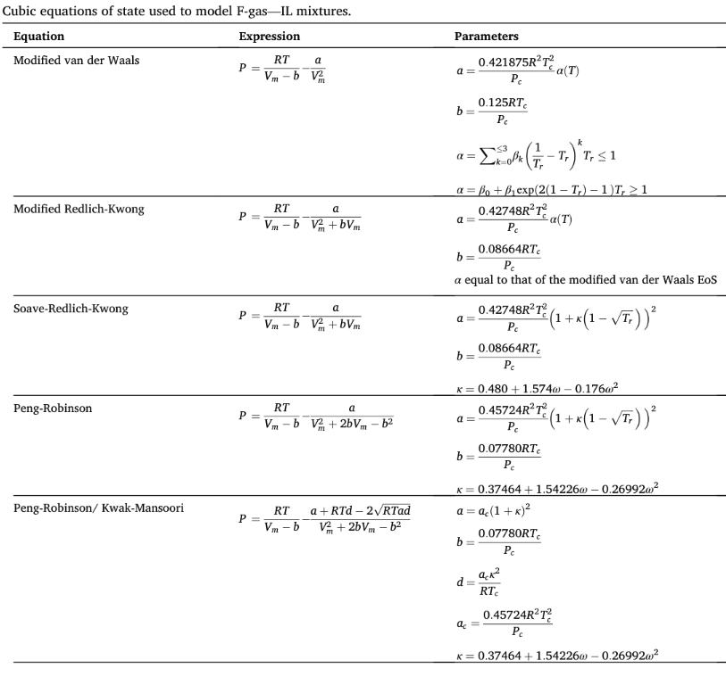
Multiple thermodynamic models are available for modeling binary solubilities for HFC and IL mixtures
Mixing Rules
Cubic EoS
+ Activity Coefficient
+ SAFT
+ …
Significance
Various HFC/IL mixtures may require different thermo models
Choice of model matters in thermo community → physical justification
Asensio-Delgado, S., et al. (2021). Sep. and Pur. Tech.
Notes:
Emphasize complexity

Slide 7
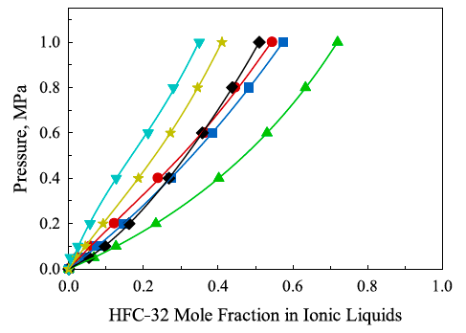
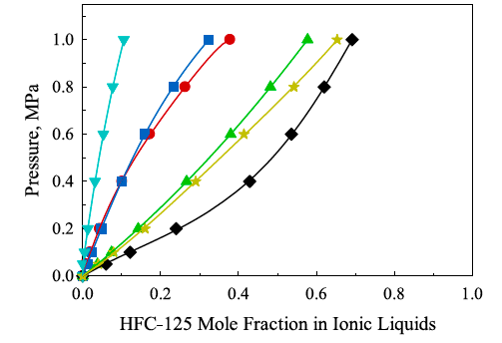
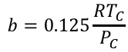
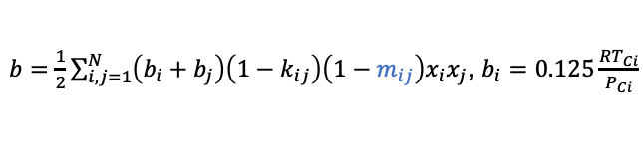
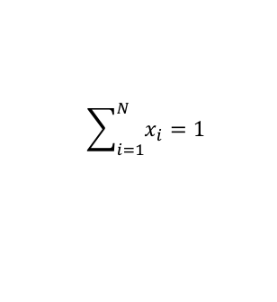
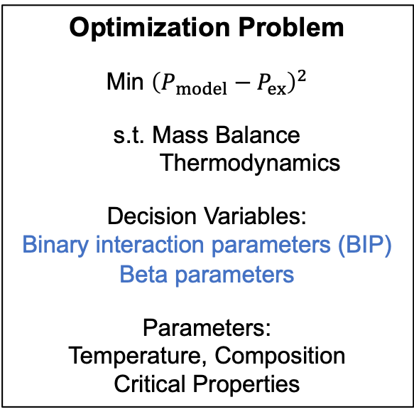
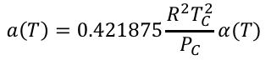
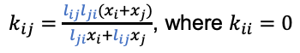
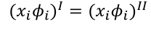
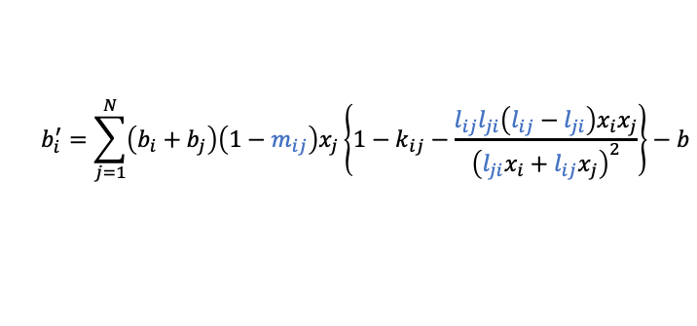
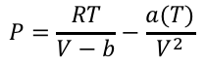
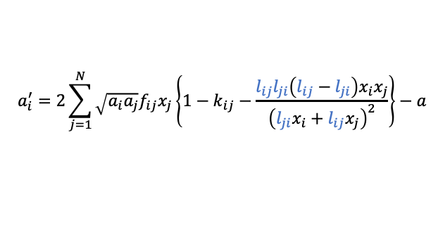
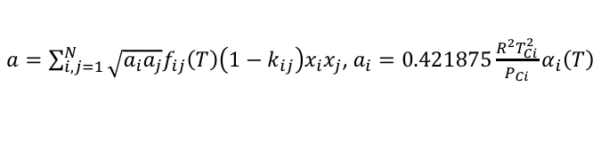
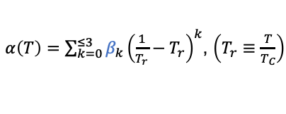
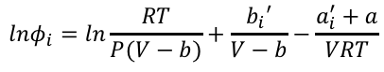
vdW and PR EoS provide good fits to the experimental data
$$P=\frac{RT}{V−b}−\frac{a(T)}{V^{2}}$$
Optimization Problem
Min ${\left(P_{model}−P_{ex}\right)}^{2}$
s.t. Mass Balance
Thermodynamics
Decision Variables:
Binary interaction parameters (BIP)
Beta parameters
Parameters:
Temperature, Composition
Critical Properties
$b=\frac{1}{2}\sum_{i,j=1}^{N}{\left(b_{i}+b_{j}\right)\left(1−k_{ij}\right)\left(1−m_{ij}\right)x_{i}x_{j}}$, $b_{i}=0.125\frac{RT_{Ci}}{P_{Ci}}$
$$a\left(T\right)=0.421875\frac{R^{2}T_{C}^{2}}{P_{C}}α(T)$$
$$lnφ_{i}=ln\frac{RT}{P(V−b)}+\frac{b_{i}′}{V−b}−\frac{a_{i}^{′}+a}{VRT}$$
$$b=0.125\frac{RT_{C}}{P_{C}}$$
$$a_{i}^{′}=2\sum_{j=1}^{N}{\sqrt{a_{i}a_{j}}f_{ij}x_{j}\left\{1−k_{ij}−\frac{l_{ij}l_{ji}\left(l_{ij}−l_{ji}\right)x_{i}x_{j}}{{\left(l_{ji}x_{i}+l_{ij}x_{j}\right)}^{2}}\right\}−a}$$
$α\left(T\right)=\sum_{k=0}^{≤3}{β_{k}{\left(\frac{1}{T_{r}}−T_{r}\right)}^{k}}$, $\left(T_{r}≡\frac{T}{T_{C}}\right)$
$$b_{i}^{′}=\sum_{j=1}^{N}{\left(b_{i}+b_{j}\right)\left(1−m_{ij}\right)x_{j}\left\{1−k_{ij}−\frac{l_{ij}l_{ji}\left(l_{ij}−l_{ji}\right)x_{i}x_{j}}{{\left(l_{ji}x_{i}+l_{ij}x_{j}\right)}^{2}}\right\}−b}$$
$a=\sum_{i,j=1}^{N}{\sqrt{a_{i}a_{j}}f_{ij}\left(T\right)\left(1−k_{ij}\right)x_{i}x_{j}}$, $a_{i}=0.421875\frac{R^{2}T_{Ci}^{2}}{P_{Ci}}α_{i}\left(T\right)$
$${{(x}_{i}φ_{i})}^{I}={{(x}_{i}φ_{i})}^{II}$$
$f_{ij}\left(T\right)=1+\frac{τ_{ij}}{T}$, where $τ_{ij}=τ_{ji}$ and $τ_{ii}=0$
$k_{ij}=\frac{l_{ij}l_{ji}(x_{i}+x_{j})}{l_{ji}x_{i}+l_{ij}x_{j}}$, where $k_{ii}=0$
$$\sum_{i=1}^{N}{x_{i}}=1$$
[bmim][SCN] [hmim][Cl] [bmim][C₁CO₂]
[bmim][BF₄] [bmim][PF₆] [hmim][FAP]
Points – experiments
Lines – model fits
Observations
5-9 fitted parameters
Complicated refrigerant-lubricant mixing rules
Shiflett, M. and Yokozeki, A. J. Supercritical Fluids, 55(2). (2010).
Morais, A. Harders, A. Baca, K. Olsen, G. Befort, B. Dowling, A. Maginn, E. Shiflett, M. IECR, 59(40). (2020).
Notes:
Goal: Reproduce pressure, given temperature and composition
Add back up slide with g-phi method and sensitivity analyses
Shows how we are making adjustments when our old methods can’t help
SAFT: Helmholtz energy residual in terms of hard sphere, chains, association (h-bond) and dispersions
PC-SAFT: used hard chains as the reference fluid and can deal with polar molecules
Soft-SAFT: LJ reference fluid

Slide 8
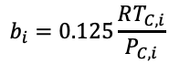
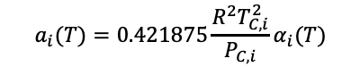
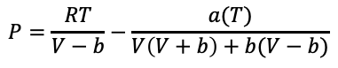
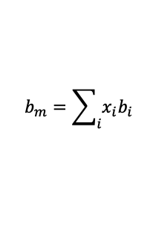
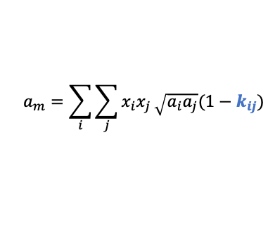


vdW and PR EoS provide good fits to the experimental data
$$P=\frac{RT}{V−b}−\frac{a(T)}{V\left(V+b\right)+b(V−b)}$$
Optimization Problem
Min ${\left(P_{model}−P_{ex}\right)}^{2}$
s.t. Mass Balance
Thermodynamics
Decision Variables:
Binary interaction parameters ($k_{ij}$)
Parameters:
Temperature, Composition
Critical Properties
$$a_{i}(T)=0.421875\frac{R^{2}T_{C,i}^{2}}{P_{C,i}}α_{i}(T)$$
Observations
1 parameter minimum
Simple vdW mixing rules
Similar goodness of fit to vdW EoS
$$α_{i}\left(T\right)={\left(1+\left(1−{\left(\frac{T}{T_{C}}\right)}^{2}\right)\left(0.37464+1.54226ω_{i}−0.26992ω_{i}^{2}\right)\right)}^{2}$$
$$b_{i}=0.125\frac{RT_{C,i}}{P_{C,i}}$$
$$a_{m}=\sum_{i}{\sum_{j}{x_{i}x_{j}}\sqrt{a_{i}a_{j}}(1−k_{ij})}$$
$$b_{m}=\sum_{i}{x_{i}b_{i}}$$
[emim][Cl] [hmim][I] [hmim][Br] [pmim][Cl]
[bmim][Cl] [hmim][Cl] [P_{14,6,6,6}][Cl]
Points – experiments
Lines – model fits
Baca, K. Olsen, G. Matamoros Valenciano, L. Bennet, M. Haggard, D. Befort, B. Garciadiego, A. Dowling, W. Maginn, E. Shiflett, M. Sus. Chem. & Engr. (2021)
Notes:
Goal: Reproduce pressure, given temperature and composition
Add back up slide with g-phi method and sensitivity analyses
Shows how we are making adjustments when our old methods can’t help
SAFT: Helmholtz energy residual in terms of hard sphere, chains, association (h-bond) and dispersions
PC-SAFT: used hard chains as the reference fluid and can deal with polar molecules
Soft-SAFT: LJ reference fluid

Slide 9

Thermodynamic modeling enables us to move from data to designs and gain fundamental insights
Monte Carlo Parameter Uncertainty Analysis
IL Critical Point Sensitivity Analyses
Uncertainty Propagation Through Process Model
Observations
Provides insight into
Parameter correlation
IL properties
Expected ranges of process variables
Important for
Process decisions
Determining acceptable levels of data and model accuracy
Understanding molecular and process trade-offs
Morais, A. Harders, A. Baca, K. Olsen, G. Befort, B. Dowling, A. Maginn, E. Shiflett, M. IECR, 59(40). (2020).
Notes:
We still have more to do with this thermos modeling work, but this is an example of how we can begin to build insights from multiple design length scales into our data-to-design framework

Slide 10
Our data-to-design framework enables exploration of how thermodynamic modeling can guide experimental decisions
Summary
Variety of available data from experimentalists
Multiple thermo models available which give good fits
Questions
Can we use traditional statistical methods to rigorously determine which thermodynamic model to use?
Can this analysis inform experimental collaborators on which data is most important to measure?
Experiments
Thermophysical Property Targets & IL Design
Process Design
Recovery Fraction
Temperature
Technoeconomic
Analysis
Turnaoglu, Ritchie & Shiflett (2019), J. Chem. Eng. Data
Shiflett, M. B. and Yokozeki, A. Chimica Oggi - Chemistry Today, 24(2). (2006).
Thermodynamic Modeling & Parameter Estimation
Molecular Simulations
Vapor Box
Liquid Box
$$P=\frac{RT}{V−b}−\frac{a}{V^{2}−ubV+wb^{2}}$$
$$a_{m}=\sum_{i}{\sum_{j}{y_{i}y_{j}}\sqrt{a_{i}a_{j}}(1−κ_{ij})}$$
$$μ_{i}^{V} =μ_{i}^{L}$$
$$P^{V}=P^{L}$$
$$T^{V}=T^{L}$$
$$a_{j}=0.421875\frac{R^{2}T_{Cj}^{2}}{P_{Cj}}α_{j}$$
$$b_{j}=0.125\frac{RT_{Cj}}{P_{Cj}}$$
Mullen, Corcelli & Maginn (2018), : J. Phys. Chem. Lett.
$$b_{m} \sum_{i=1}^{N}{x_{i}}=1$$
Choice of thermodynamic model may impact process design and uncertainty results!

Slide 11










Case study: Peng-Robinson EoS with temperature dependent data
System
HFC-32 solubility in [emim][TF2N]
2 parameters: $k_{ij}, k_{ji}$
Optimization Problem
Min ${\left(P_{model}−P_{ex}\right)}^{2}$
s.t. Mass Balance
Thermodynamics
Decision Variables:
Binary interaction parameters ($k_{ij}$)
Parameters:
Temperature, Composition
Critical Properties
$$P=\frac{RT}{V−b}−\frac{a(T)}{V\left(V+b\right)+b(V−b)}$$
$$a_{i}(T)=0.421875\frac{R^{2}T_{C,i}^{2}}{P_{C,i}}α_{i}(T)$$
$$α_{i}\left(T\right)={\left(1+\left(1−{\left(\frac{T}{T_{C}}\right)}^{2}\right)\left(0.37464+1.54226ω_{i}−0.26992ω_{i}^{2}\right)\right)}^{2}$$
$$b_{i}=0.125\frac{RT_{C,i}}{P_{C,i}}$$
$$a_{m}=\sum_{i}{\sum_{j}{x_{i}x_{j}}\sqrt{a_{i}a_{j}}(1−k_{ij})}$$
$$b_{m}=\sum_{i}{x_{i}b_{i}}$$
$$a_{m}=\sum_{i}{\sum_{j}{x_{i}x_{j}}\sqrt{a_{i}a_{j}}(1−k_{ij,A}+\frac{T}{T_{R}}k_{ij,B}+{\left(\frac{T}{T_{R}}\right)}^{2}k_{ij,C}+{\left(\frac{T}{T_{R}}\right)}^{3}k_{ij,D}}$$
Questions
How do thermodynamic models compare for the same system?
How do thermodynamic models compare between different HFC and IL systems?
Observations
Parameter values decrease as temperature increases
Notes:
Add GF temp dependence plot to set up
Can combine to 1 equation
Then – how do we evaluate, model selection

Slide 12
Traditional statistical methods aid in understanding thermodynamic model questions
What data is needed from our experimental collaborators?
Goal
Quantitatively determine which model best balances complexity and fit
Varying temperature
Model Selection
Akaike information criteria (AIC) ranks models by balancing model fit and model parsimony
$$AIC\left(M\right)=−2log⁡(likelihood_{max}\left(M\right))+2dim⁡(M)$$
Model
[emim][Cl]
[hmim][I]
[hmim][Br]
[pmim][Cl]
[bmim][Cl]
[hmim][Cl]
[P_{14,6,6,6}][Cl]
Maximum likelihood estimate
Number of fitted parameters
Multiple ILs at single temperature
Output
Models ranked lowest (best model) to highest (worst model) AIC value
Claeskens, G. and Hjort, N. Cambridge Books. (2008).
Kramer, S. and Sorensen, H. IEEE Trans. On Automatic Control, 33(2). (1988).

Slide 13
Models Available (Pt. 1)
i – HFC
j – IL
Model | Number of Parameters | Temperature Dependence | Fitting | Available for HFC-32/[emim][TF2N] | Available for HFC-32/[bmimPF6] | Available for HFC-125/[emim][TF2N]
PR | 1 | None | k_{ij,A} | yes | no | yes
PR | 1 | None | k_{ji,A} | yes | no | yes
PR | 1 | None | k_{ij,A}=-0.05 k_{ji,A} | yes | - | -
PR | 2 | None | k_{ij,A} k_{ji,A} | yes | yes | yes
PR | 3 | Linear | k_{ij,A}, k_{ji,A} k_{ij,B} | yes | yes | yes
PR | 3 | Linear | k_{ij,A}, k_{ji,A} k_{ji,B} | yes | yes | yes
PR | 4 | Linear | k_{ij,A}, k_{ji,A} k_{ij,B}, k_{ji,B} | yes | yes | yes
PR | 6 | Quadratic | k_{ij,A}, k_{ji,A} k_{ij,B}, k_{ji,B} k_{ij,C}, k_{ji,C} | yes | yes | yes
PR | 8 | Polynomial | k_{ij,A}, k_{ji,A} k_{ij,B}, k_{ji,B} k_{ij,C}, k_{ji,C} k_{ij,D}, k_{ji,D} | yes | noo | no

Slide 14
Models Available (Pt. 2)
i – HFC
j – IL
Model | Number of Parameters | Temperature Dependence | Fitting | Available for HFC-32/[emim][TF2N] | Available for HFC-32/[bmimPF6] | Available for HFC-125/[emim][TF2N]
SRK | 1 | None | k_{ij,A} | yes | no | yes
SRK | 1 | None | k_{ji,A} | yes | yes | yes
SRK | 2 | None | k_{ij,A} k_{ji,A} | yes | yes | yes
SRK | 3 | Linear | k_{ij,A}, k_{ji,A} k_{ij,B} | yes | yes | yes
SRK | 3 | Linear | k_{ij,A}, k_{ji,A} k_{ji,B} | yes | yes | yes
SRK | 4 | Linear | k_{ij,A}, k_{ji,A} k_{ij,B}, k_{ji,B} | yes | yes | yes
SRK | 6 | Quadratic | k_{ij,A}, k_{ji,A} k_{ij,B}, k_{ji,B} k_{ij,C}, k_{ji,C} | yes | yes | yes
SRK | 8 | Polynomial | k_{ij,A}, k_{ji,A} k_{ij,B}, k_{ji,B} k_{ij,C}, k_{ji,C} k_{ij,D}, k_{ji,D} | yes | no | no
NRTL | 2 | - |  | TBD | TBD | TBD

Slide 15



Model Selection: HFC-32/[emim][TF2N]
SRK – 8 parameter
SRK – 4 parameter
Observations
SRK + polynomial temperature dependence should be selected
Or, promote SRK (8), SRK (6), PR (6), PR(4) for further study
Experimentalists: Data at multiple temperatures is needed to obtain best fits from thermo models
Objective Units: 1E-9*Pa²

Slide 16


Different systems give different results
R-32/[bmim][PF6]
R-125/[emim][TF2N]
Observations
We get different results for different systems!
Additional analyses: evaluate optimality metrics, identifiability
Objective Units: 1E-9*Pa²
Notes:
+ Optimality
+ Identifiability results for now

Slide 17


Statistical analysis guides model selection for HFC-32/[emim][TF2N] solubility
Parameter
Temperature Dependence
$$a_{m}=\sum_{i}{\sum_{j}{x_{i}x_{j}}\sqrt{a_{i}a_{j}}(1−k_{ij,A}+\frac{T}{T_{R}}k_{ij,B}+{\left(\frac{T}{T_{R}}\right)}^{2}k_{ij,C})}$$
None
2 Fitted Parameters
Residual: 11.5E3 Pa²
Akaike Information Criteria
$$AIC\left(M\right)=−2log⁡(likelihood_{max}\left(M\right))+2dim⁡(M)$$
Model | AIC | Relative Likelihood | Rank
2 parameter | 13.2 | 0.0011 | 3
4 parameter | 1.41 | 0.39 | 2
6 parameter | -0.483 | 1.0 | 1
Linear
4 Fitted Parameters
Residual: 0.0451E3 Pa²
Observations
Quadratic temperature dependence in the parameters gives both the lowest residual and is ranked 1 by AIC
Experimentalists: Data at multiple temperatures is needed to obtain best fits from thermo models
Quadratic
6 Fitted Parameters
Residual: 0.0439E3 Pa²
Notes:
6 parameter is smaller because its MLE is more balance by the number of parameters than the 4 parameter model

Slide 18
Success story: Data science tools provide experimental guidance
AIC analysis is a straightforward methods to address thermodynamic modeling questions and inform decisions within data-to-design framework
Experiments
Thermophysical Property Targets & IL Design
Process Design
Recovery Fraction
Temperature
Technoeconomic
Analysis
Turnaoglu, Ritchie & Shiflett (2019), J. Chem. Eng. Data
Shiflett, M. B. and Yokozeki, A. Chimica Oggi - Chemistry Today, 24(2). (2006).
Thermodynamic Modeling & Parameter Estimation
Molecular Simulations
Vapor Box
Liquid Box
$$P=\frac{RT}{V−b}−\frac{a}{V^{2}−ubV+wb^{2}}$$
$$a_{m}=\sum_{i}{\sum_{j}{y_{i}y_{j}}\sqrt{a_{i}a_{j}}(1−κ_{ij})}$$
$$μ_{i}^{V} =μ_{i}^{L}$$
$$P^{V}=P^{L}$$
$$T^{V}=T^{L}$$
$$a_{j}=0.421875\frac{R^{2}T_{Cj}^{2}}{P_{Cj}}α_{j}$$
$$b_{j}=0.125\frac{RT_{Cj}}{P_{Cj}}$$
Mullen, Corcelli & Maginn (2018), : J. Phys. Chem. Lett.
$$b_{m} \sum_{i=1}^{N}{x_{i}}=1$$

Slide 19
Exciting opportunities for future work!
Grant No. 1917474
Add in NRTL model
Try Baron
DoE for model discrimination
IL critical property sensitivity analysis
Volatility comparison between models
Notes:
As an example, we envision that this will be used in a variety of projects, including further in HFC multiscale engineering applications, such as the one shown here. To this end, ongoing work includes understanding the transferability of our force field to other untuned properties and using this framework to optimize an entire class of HFC molecules. Eventually we plan to integrate this workflow into a computed aided multiscale design scheme for HFC phaseout.

Slide 20
Exciting opportunities for future work!
Grant No. 1917474
Expand model selection to include other types of thermo models
Implement automatic model selection in workflow
Use workflow to provide molecule and process design specifications
Determine most important IL properties for efficient separations
Notes:
As an example, we envision that this will be used in a variety of projects, including further in HFC multiscale engineering applications, such as the one shown here. To this end, ongoing work includes understanding the transferability of our force field to other untuned properties and using this framework to optimize an entire class of HFC molecules. Eventually we plan to integrate this workflow into a computed aided multiscale design scheme for HFC phaseout.

Slide 21




Acknowledgements
Questions?
Email: bbefort@nd.edu
Dowling Group
Grant No. 1917474
Maginn Group
Shiflett Group

